Slide 1
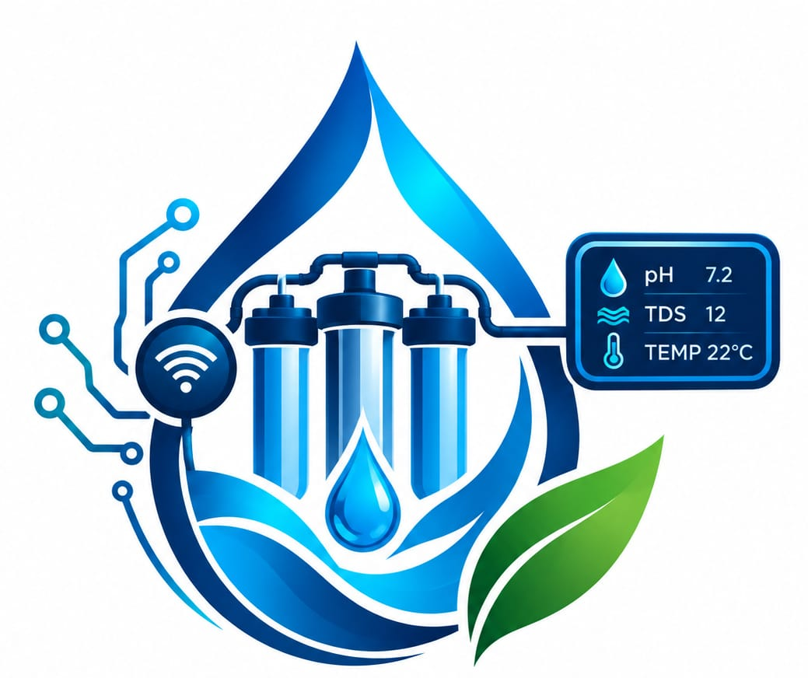
Introducing purifitech

Slide 2
Problem statement
Mpumalanga’s water infrastructure is threatened by toxic runoff from coal-mining activities, particularly Acid Mine Drainage (AMD), which can negatively affect water quality and make continuous monitoring and treatment necessary.
Traditional water purification processes often rely on manual monitoring and do not provide real-time information about changes in water quality or the progress of the purification process.

Slide 3
solution
PurifiTech is a smart water purification and monitoring system designed to provide continuous monitoring and rapid response in decentralized water-treatment environments.
Our system:
*Monitors key water-quality indicators continuously
*Detects abnormal conditions early
*Responds automatically through a valve or dosing pump
*Visualizes the treatment system through a 3D Digital Twin
*Records water-quality data and system events

Slide 4
System Methodology
1. SENSE
Sensors continuously measure selected water-quality parameters.
2. DETECT
The system processes readings locally and identifies abnormal conditions.
3. DECIDE
The system determines the appropriate predefined response.
4. ACT
A physical action is triggered — such as closing a valve or activating a dosing pump.

Slide 5
System Methodology cont.
5. VISUALIZE
The dashboard and 3D Digital Twin show the system's status and affected section.
6. RECORD
Readings, alerts and actions are stored for historical analysis and reporting.
SENSE → DETECT → DECIDE → ACT → VISUALIZE → RECORD

Slide 6
COMMERCIALISATION PATHWAY:
PurifiTech will progress from a prototype → field testing → pilot deployment → commercial product.
It will generate revenue through hardware sales, software subscriptions, installation, monitoring and maintenance, targeting mining companies, water-treatment facilities, municipalities and industrial users.

Slide 7
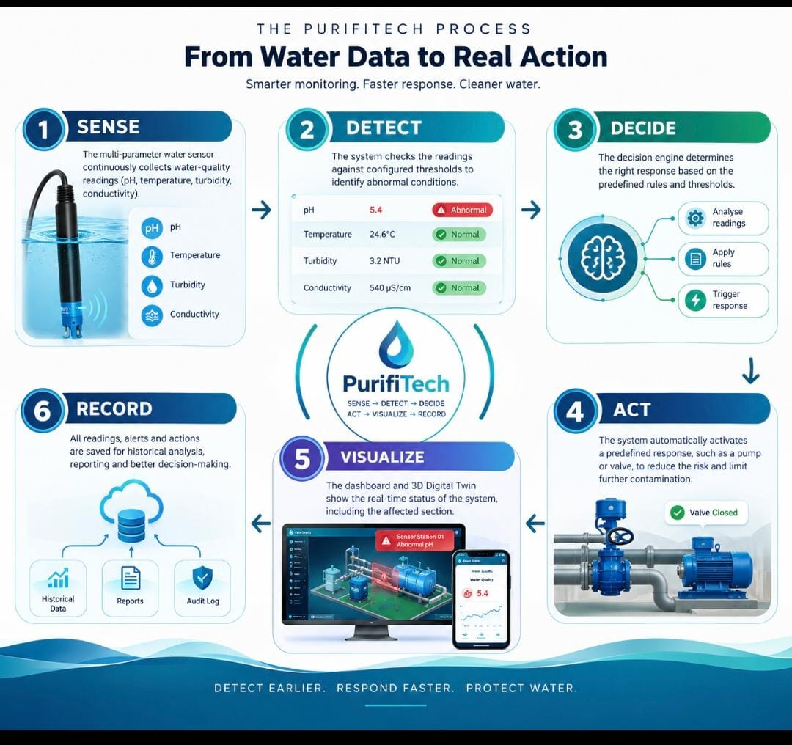

Slide 8
Target Market
1. Mining companies
2. Water-treatment operators
3. Municipalities
4. Industrial facilities

